Slide 1


Research on Stock Price Prediction and Quantitative Strategies
based on Deep Learning
Reporter：SHUI YUE

Slide 2

上海立信会计金融学院
Shanghai Lixin University of Accounting and Finance
01
Abstract
02
A Comparative Study of LSTM, GRU and BiLSTM on Stock Closing Price Prediction
03
Quantitative Investment Strategy based on Lightgbm-BiLSTM
04
Research Prospect

Slide 3

上海立信会计金融学院
Shanghai Lixin University of Accounting and Finance
01
PART I
Abstract
PART I

Slide 4


Abstract
Brief Introduction
The first part of the experiments in this paper uses the SPDB and IBM data to build stock prediction models with LSTM, GRU, and BiLSTM, respectively. By comparing the prediction results of these three deep learning models, it is found that for both datasets the BiLSTM model outperforms the other models and has better prediction accuracy. The second part uses the complete-market stock data of A-share and uses the Lightgbm model to filter the 50 price-volume factors and select the 10 factors with the highest importance. After that, the BiLSTM model is used to combine the factors and establish a quantitative investment strategy. Finally, the strategy is empirically tested and back-tested, and it is found that the strategy outperforms the market benchmark index, which illustrates the practical application value of the BiLSTM model in stock price prediction and quantitative investment.

Slide 5

上海立信会计金融学院
Shanghai Lixin University of Accounting and Finance
PART II
A comparative study of LSTM, GRU and BiLSTM on stock closing price prediction
02
PART II

Slide 6
SPDB Data
Partial Presentation of the SPDB Dataset
Data source: Tushare financial big data platform
[ 3114rows x 7columns]

Slide 7
IBM Data
Partial Presentation of the IBM Dataset
Data source: ： Yahoo Finance
[7278rows x 7columns]

Slide 8
Prediction Results of SPDB
Comparison of Evaluation Index
It can be found that the MSE, RMSE and MAE of the BiLSTM model are smaller than those of the LSTM model and the GRU model, while the R-squared are larger than those of the LSTM model and the GRU model, which indicates that the BiLSTM model fits better.

Slide 9
Prediction Results of IBM
Comparison of Evaluation Index
It can be found that the MSE, RMSE and MAE of the BiLSTM model are smaller than those of the LSTM model and the GRU model, while the R-Squared are larger than those of the LSTM model and the GRU model, which indicates that the BiLSTM model fits better.

Slide 10

上海立信会计金融学院
Shanghai Lixin University of Accounting and Finance
PART III
Quantitative investment strategy based on Lightgbm-BiLSTM
03
PART III

Slide 11
Complete-market Daily Dataset of A-share
Partial Presentation of the Complete-market Daily Dataset of A-share
Data source: Tushare financial big data platform
[5872309 rows x 11 columns]

Slide 12
Daily Data Set of CSI All Share Index
Partial Presentation of the Daily Data Set of CSI All Share Index
Data source: Tushare financial big data platform
[5057 rows x 7 columns]

Slide 13
The following price-volume factors were obtained using genetic programming and
manual data mining methods.
Price-volume Factors
Partial Price-volume Factors

Slide 14
After IR testing, the table shown below is obtained in descending order of IR. From the table below we can see that the IR of all the 50 selected price-volume factors is greater than 0.5, which indicates that these factors have a strong ability to obtain excess returns steadily.
Factor Testing
IR Test Table for the Factors

Slide 15
Factor selection was performed using LightGBM, and the top ten factors were ranked according to factor importance as the factors selected for this cross-section
Factor Selection of LightGBM
Ranking of the Importance of Some Selected Factors

Slide 16
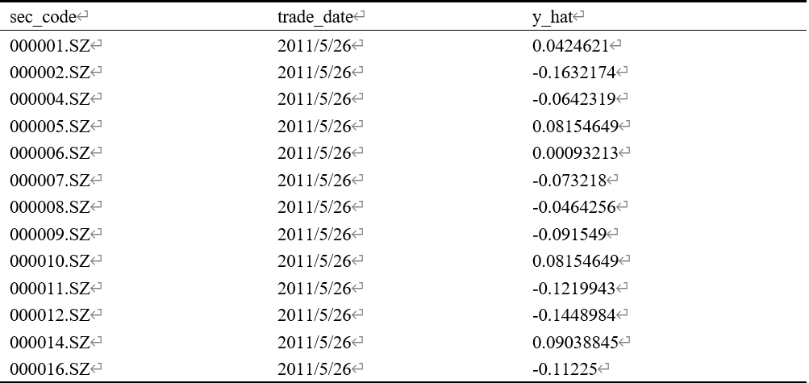
Factor combination was performed using BiLSTM, and we can get the expected return of each stock in the next month.
Factor Combination of BiLSTM
Partial Returns of Stocks

Slide 17
Investment Strategy and Backtesting
Investment Strategy and Backtesting
The quantitative trading strategy in this paper is to convert positions every other month (i.e., a 28-trading-day transfer cycle), and each position convertibility takes the form of buying the 25 stocks with the highest expected returns predicted by BiLSTM in equal shares and selling the stocks originally held. The backtesting time and rules in this paper are as follows.
（1）Backtesting period: from January 2012 to October 2020.
（2）Backtest stock pool: All A-shares, excluding Special treatment (ST) stocks.
（3）Trading commission: 2% per thousand for buying and 2% per thousand for selling, of which if the commission for a single transaction is less than $5, the securities trader will charge a trading commission of $5.
（4）Buying and selling rules: If the stock hits the limit-up the day, the stock cannot be bought, and if it hits limit-down, the stock cannot be sold.

Slide 18
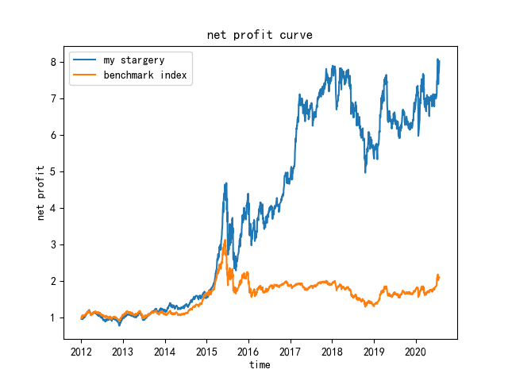
Backtesting Results and Analysis
Strategy Backtesting Results
Total
Annualized
Annualized
Sharpe
Maximum
Annualized
Annualized
rate
of
return
rate of return
volatility
ratio
drawdown
turnover
rate
transaction
cost
rate
my trategy
701.00%
29.18%
33.44%
0.77
51.10%
11.35
2.29%
benchmark
110.40%
9.70%
26.01%
0.24
58.49%
0.00
0.00%
1.As can be seen from the results above, the total rate of return and annualized rate of return of this strategy are much higher than the benchmark, and the Sharpe ratio is higher than the benchmark. These three backtesting indexes show that the Lightgbm-BiLSTM quantitative strategy is indeed able to deliver greater returns to investors.
2. The annualized volatility of this strategy is greater than the benchmark, and the maximum drawdown is less than the benchmark. These two backtesting indexes indicate that the Lightgbm-BiLSTM quantitative strategy has some risk, especially it is very difficult to withstand shocks of systematic risk.
3. Overall, the return of this Lightgbm-BiLSTM quantitative strategy is very promising, but there are still some risks.

Slide 19


上海立信会计金融学院
Shanghai Lixin University of Accounting and Finance
04
PART IV
Research Prospect
PART IV

Slide 20
Research Prospect
上海立信会计金融学院
Shanghai Lixin University of Accounting and Finance
The factors used in this paper for constructing quantitative investment strategies are all technical price-volume factors, and the variety of factors is single. In the future, different kinds of factors such as financial factor, sentiment factor, momentum factor and growth factor can be selected to improve the performance of the strategy.
Research Prospect
In the future, the quadratic programming of operations research can be used to optimize the portfolio and reduce the risk of the portfolio.

Slide 21
References
上海立信会计金融学院
Shanghai Lixin University of Accounting and Finance
[1] White H. Economic prediction using neural networks: The case of IBM daily stock returns[C]//ICNN. 1988, 2: 451-458.
[2] Kimoto T, Asakawa K, Yoda M, et al. Stock market prediction system with modular neural networks[C]//1990 IJCNN international joint conference on neural networks. IEEE, 1990: 1-6.
[3] Zhang G P. Time series forecasting using a hybrid ARIMA and neural network model[J]. Neurocomputing, 2003, 50: 159-175.
[4] Akita R, Yoshihara A, Matsubara T, et al. Deep learning for stock prediction using numerical and textual information[C]//2016 IEEE/ACIS 15th International Conference on Computer and Information Science (ICIS). IEEE, 2016: 1-6.
[5]宮崎邦洋, 松尾豊. Deep Learning を用いた株価予測の分析[C]//人工知能学会全国大会論文集 第 31 回全国大会 (2017). 一般社団法人 人工知能学会, 2017: 2D3OS19a3-2D3OS19a3.
[6] Kim T, Kim H Y. Forecasting stock prices with a feature fusion LSTM-CNN model using different representations of the same data[J]. PloS one, 2019, 14(2): e0212320.
[7]张健,陈勇,夏罡,何永保.人工神经网络之股票预测[J].计算机工程,1997(02):52-55.
[8]孙瑞奇. 基于LSTM神经网络的美股股指价格趋势预测模型的研究[D].首都经济贸易大学,2016.
[9]任君,王建华,王传美,王建祥.基于正则化LSTM模型的股票指数预测[J].计算机应用与软件,2018,35(04):44-48+108.

Slide 22
References
上海立信会计金融学院
Shanghai Lixin University of Accounting and Finance
[10]谢合亮. LSTM在多因子量化投资模型中的改进及应用研究[D].中央财经大学,2019.
[11]乔若羽. 基于注意力机制的神经网络预测模型[D].中国科学技术大学,2020.
[12] Hochreiter S, Schmidhuber J. Long short-term memory[J]. Neural computation, 1997, 9(8): 1735-1780.
[13] Cho K, Van Merriënboer B, Gulcehre C, et al. Learning phrase representations using RNN encoder-decoder for statistical machine translation[J]. arXiv preprint arXiv:1406.1078, 2014.
[14] Chung J, Gulcehre C, Cho K H, et al. Empirical evaluation of gated recurrent neural networks on sequence modeling[J]. arXiv preprint arXiv:1412.3555, 2014.
[15] Gruber N, Jockisch A. Are GRU cells more specific and LSTM cells more sensitive in motive classification of text?[J]. Frontiers in Artificial Intelligence, 2020, 3(40): 1-6.
[16] Markowitz, H. (1952). Portfolio Selection. The Journal of Finance, 7(1), 77-91. doi:10.2307/2975974.
[17] Merton R C. An analytic derivation of the efficient portfolio frontier[J]. Journal of financial and quantitative analysis, 1972: 1851-1872.
[18] Sharpe W F. Capital asset prices: A theory of market equilibrium under conditions of risk[J]. The journal of finance, 1964, 19(3): 425-442.

Slide 23
References
上海立信会计金融学院
Shanghai Lixin University of Accounting and Finance
[19] Lintner J. The Valuation of Risk Assets and the Selection of Risky Investments in Stock Portfolios and Capital Budgets[J]. Review of Economics and Statistics, 1965, 47(1): 13-37.
[20] Mossin J. Equilibrium in a capital asset market[J]. Econometrica: Journal of the econometric society, 1966: 768-783.
[21] Ross S A. The arbitrage theory of capital asset pricing[J]. Journal of Economic Theory, 1976, 13(3): 341-60.
[22] Fama E F, French K R. Common risk factors in the returns on stocks and bonds[J]. Journal of financial economics, 1993, 33(1): 3-56.
[23] Fama E F, French K R. A five-factor asset pricing model[J]. Journal of financial economics, 2015, 116(1): 1-22.
[24] Kingma D P, Ba J. Adam: A method for stochastic optimization[J]. arXiv preprint arXiv:1412.6980, 2014.
[25] Friedman J H. Greedy function approximation: a gradient boosting machine[J]. Annals of statistics, 2001: 1189-1232.
[26] Kopitar L, Kocbek P, Cilar L, et al. Early detection of type 2 diabetes mellitus using machine learning-based prediction models[J]. Scientific reports, 2020, 10(1): 1-12.

Slide 24
References
上海立信会计金融学院
Shanghai Lixin University of Accounting and Finance
[27] Ke G, Meng Q, Finley T, et al. Lightgbm: A highly efficient gradient boosting decision tree[J]. Advances in neural information processing systems, 2017, 30: 3146-3154.
[28] Bottou L, Curtis F E, Nocedal J. Optimization methods for large-scale machine learning[J]. Siam Review, 2018, 60(2): 223-311.
[29]陈守东,陈雷,刘艳武.中国沪深股市收益率及波动性相关分析[J].金融研究,2003(07):80-85.
[30] Sharpe W F. Mutual fund performance[J]. The Journal of business, 1966, 39(1): 119-138.
[31] Sharpe W F. The sharpe ratio[J]. Journal of portfolio management, 1994, 21(1): 49-58.
[32] Bachelier L. Théorie de la spéculation[C]//Annales scientifiques de l'École normale supérieure. 1900, 17: 21-86.
[33] Fromlet H. Behavioral finance-theory and practical application: Systematic analysis of departures from the homo oeconomicus paradigm are essential for realistic financial research and analysis[J]. Business economics, 2001: 63-69.
[34] Lo A W. The adaptive markets hypothesis[J]. The Journal of Portfolio Management, 2004, 30(5): 15-29.
[35] 酒井 浩之, 和泉 潔, 八木 勲, 西山 昇, 中山 慎一郎, & 山本 竜市 (2015). OS-13 金融情報学 : ファイナンスにおける人工知能応用(オーガナイズドセッション,<特集>2015年度人工知能学会全国大会(第29回))人工知能, 30(6), 784-784.

Slide 25
Thanks for listening!
Reporter：SHUI YUE

